Slide 1
Visionaries in Practice (VIP)
Giving Program
Practice groups investing in today’s research to impact tomorrow’s practice
1

Slide 2
Table of Contents
Slide 3: RSNA R&E Foundation mission and history
Slide 7: VIP Giving Program description
Slide 9: Recognition and benefits
2

Slide 3
Our Mission is Your Mission
The R&E Foundation upholds the same principle that you do: to promote the highest standard of patient care.
RSNA R&E Foundation Mission
To invest in the future of radiology by developing investigators and supporting lifelong innovative research and education.
Today’s research is tomorrow’s practice
3

Slide 4
Types of R&E Grants
Research is funded in several areas that advance the specialty, including:
Breast/Mammography
Diagnostic Radiology
Interventional Radiology
Neuroradiology
Cardiac Radiology
Quality Improvement
and many more
Research Scholar: To help prepare junior faculty to become fully-funded, independent investigators.
Research Seed: To support the preliminary or pilot phases of scientific projects.
Research Resident / Fellow: To allow trainees to devote time to a research project under the guidance of a scientific advisor.
4

Slide 5
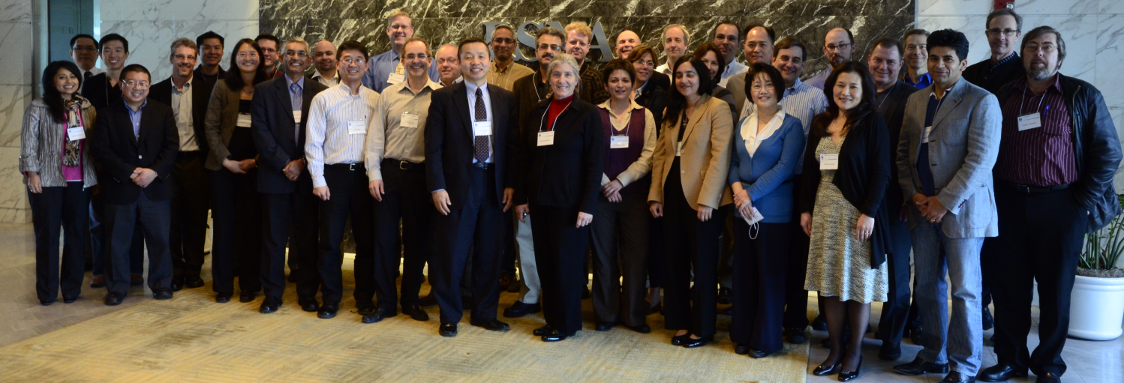
Grant Application and Review
The RSNA R&E Foundation models its grant applications and review process on those used by the NIH. The rigorous peer-review system ensures only the best science is funded.
The Radiology Research Study Section at RSNA Headquarters
5

Slide 6
Grant Funding Decisions
The Foundation’s Board of Trustees makes grant funding decisions based on scientific merit, available funds and programmatic balance
Input from study section chairs help the Board determine the quality line for each grant program
Minimum funding rate goal of 25%
6

Slide 7
Visionaries in Practice (VIP)
Giving Program
Established in 2005, the VIP Giving Program recognizes private practice groups and academic institutions making valuable investments in radiologic research and development with group donations to the RSNA R&E Foundation.
Over $6 million in funding has been dedicated to advancing research and education in medical imaging.
With your generous gifts we
all can continue to invest in the future!
7

Slide 8
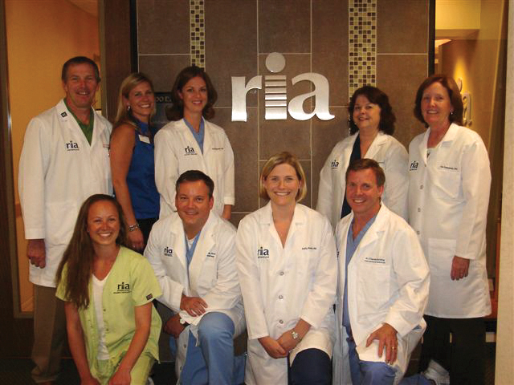
Annual VIP Giving Levels
Gifts of $10,000 + receive recognition at the RSNA annual meeting and in publications.
“Our specialty’s survival depends on the ability of radiology collectively, and radiologists individually, to demonstrate our relevance. RIA donates through the VIP Giving Program to support the research that demonstrates our collective value.”
- Peter Ricci, MD
Radiology Imaging Associates
8

Slide 9
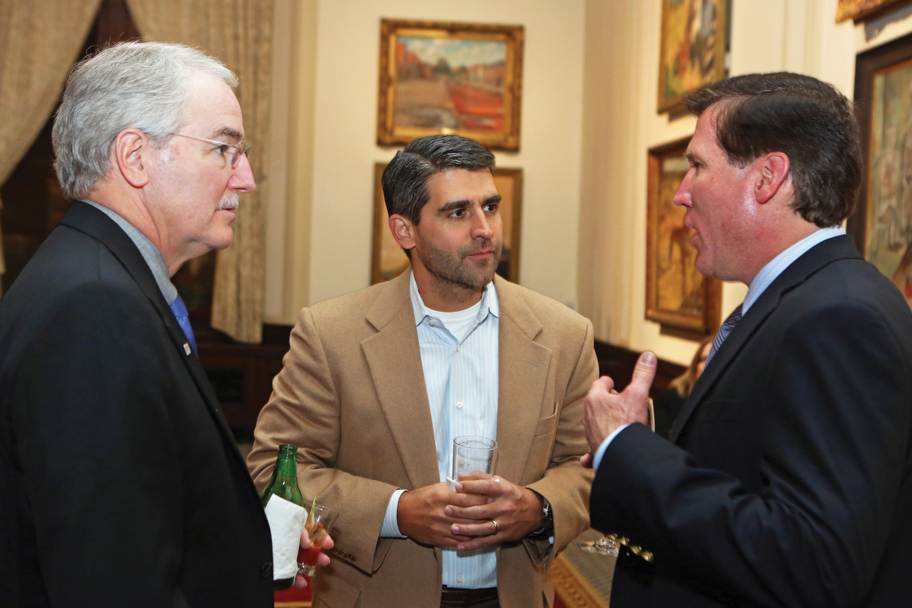
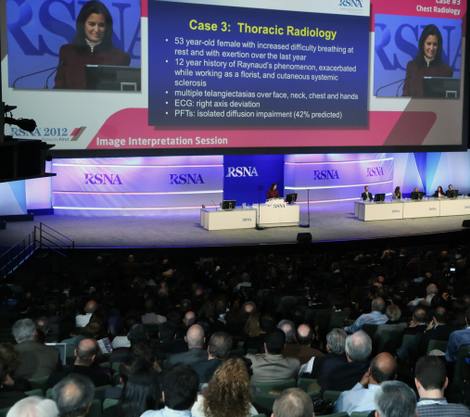
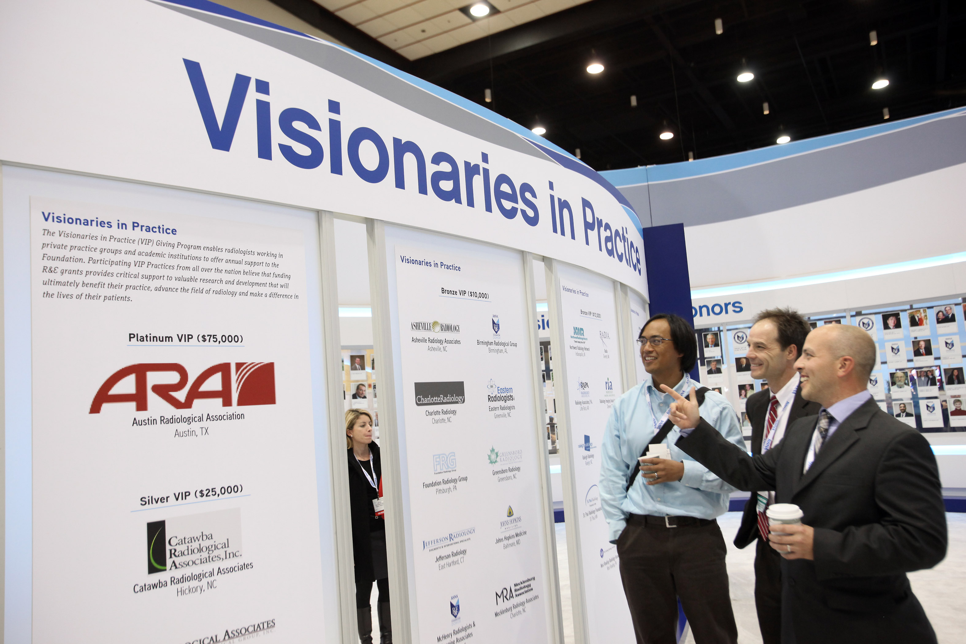
Recognition and Benefits –
at the RSNA annual meeting
Special recognition in signage and in meeting publications
Access to R&E Donor Suite
Early registration for hotel rooms prior to RSNA annual meeting (Silver level and up)
Network with leaders in the field at the Distinguished Donor Reception
Access to the front of taxi and shuttle bus lines from McCormick Place to your destination (Silver level and up)
Complimentary ground transportation for up two practice members (Gold level and up)
Complimentary lunch at Cafe RSNA (Platinum level)
*Donation deadline for annual meeting
recognition and benefits is September 30 of each year
9

Slide 10
Recognition and Benefits –
Throughout the Year
Special recognition in RSNA publications like RSNA News and RadioGraphics
Press release indicating your support for patient care
Complimentary preferred job postings in Radiology and on Career Connect
10

Slide 11
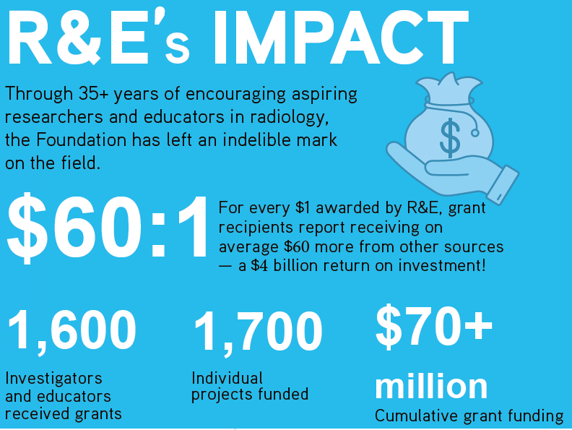
$60:$1 Return on Your Investment
11

Slide 12
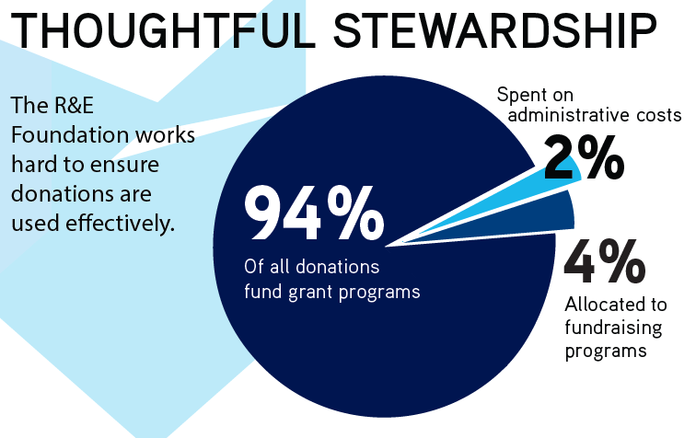
12

Slide 13
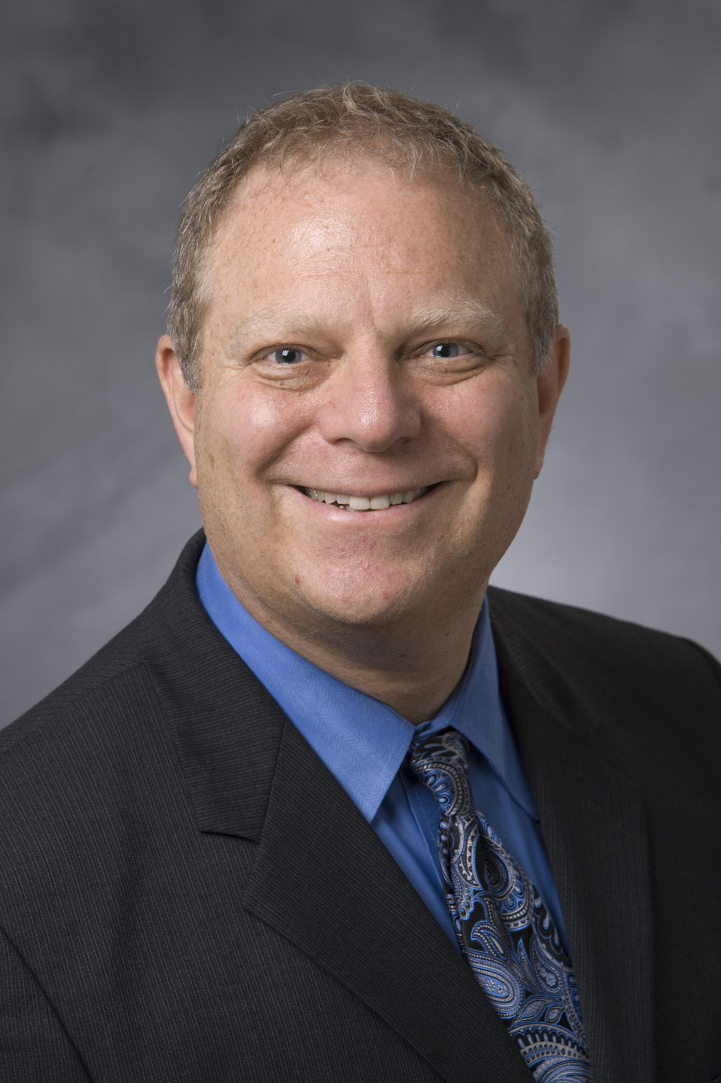
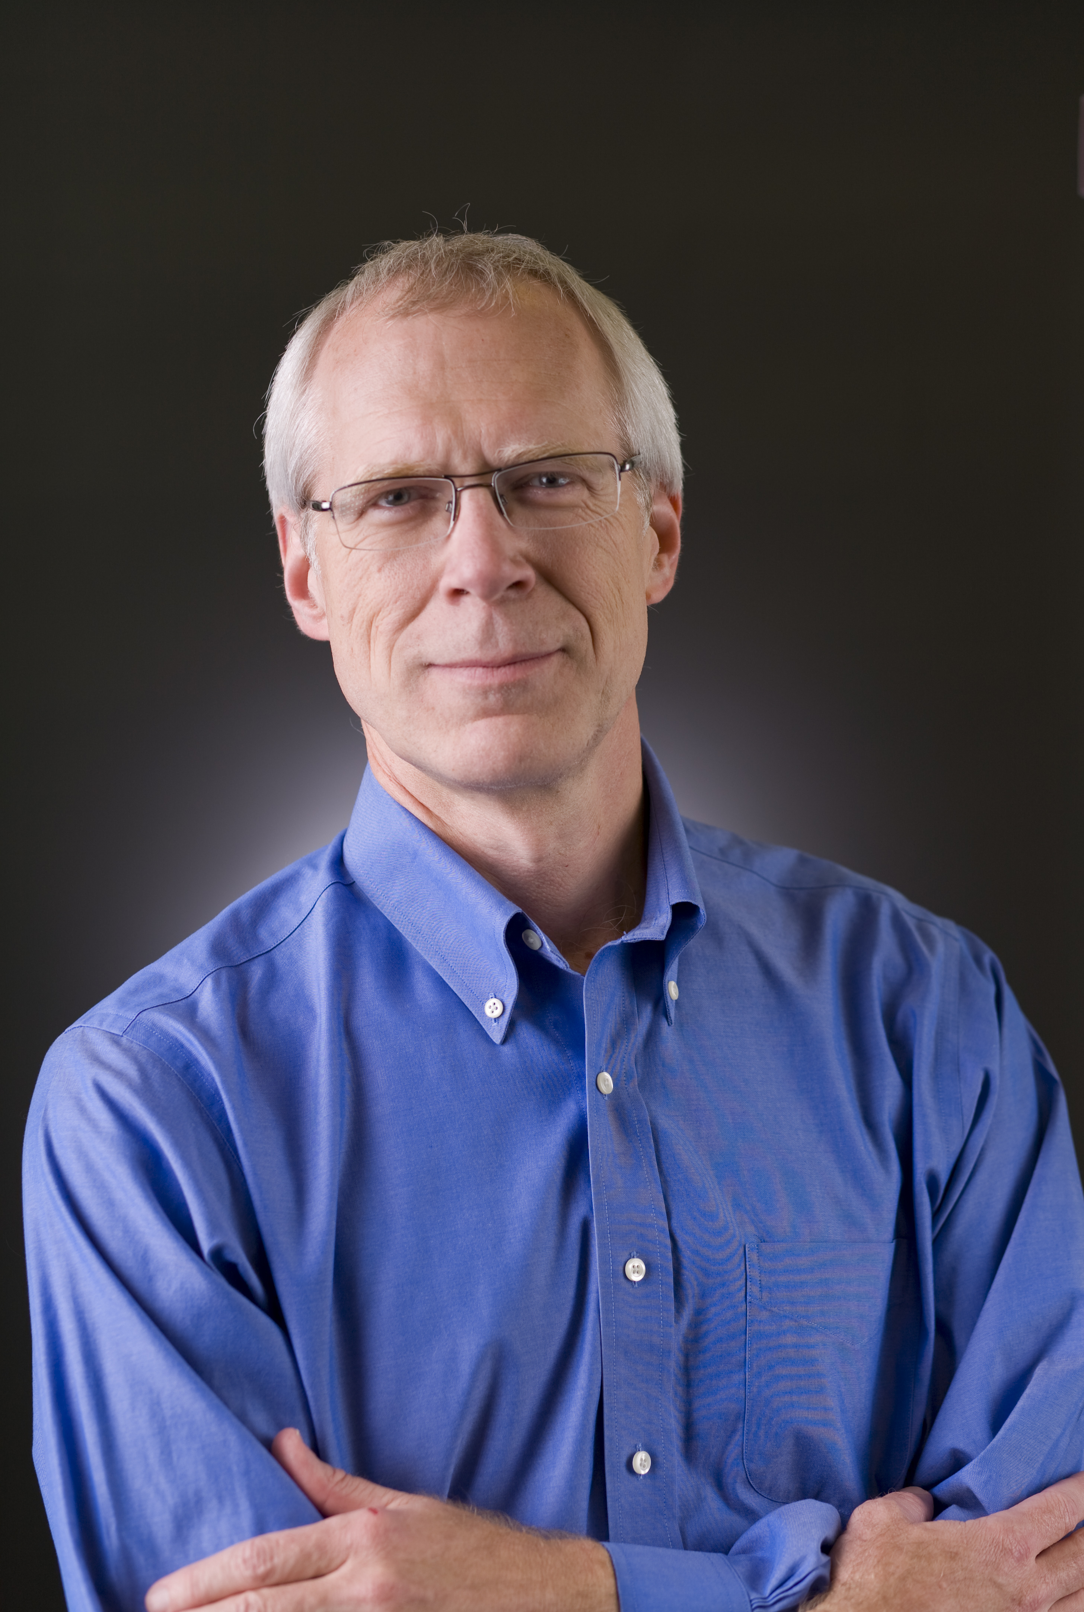
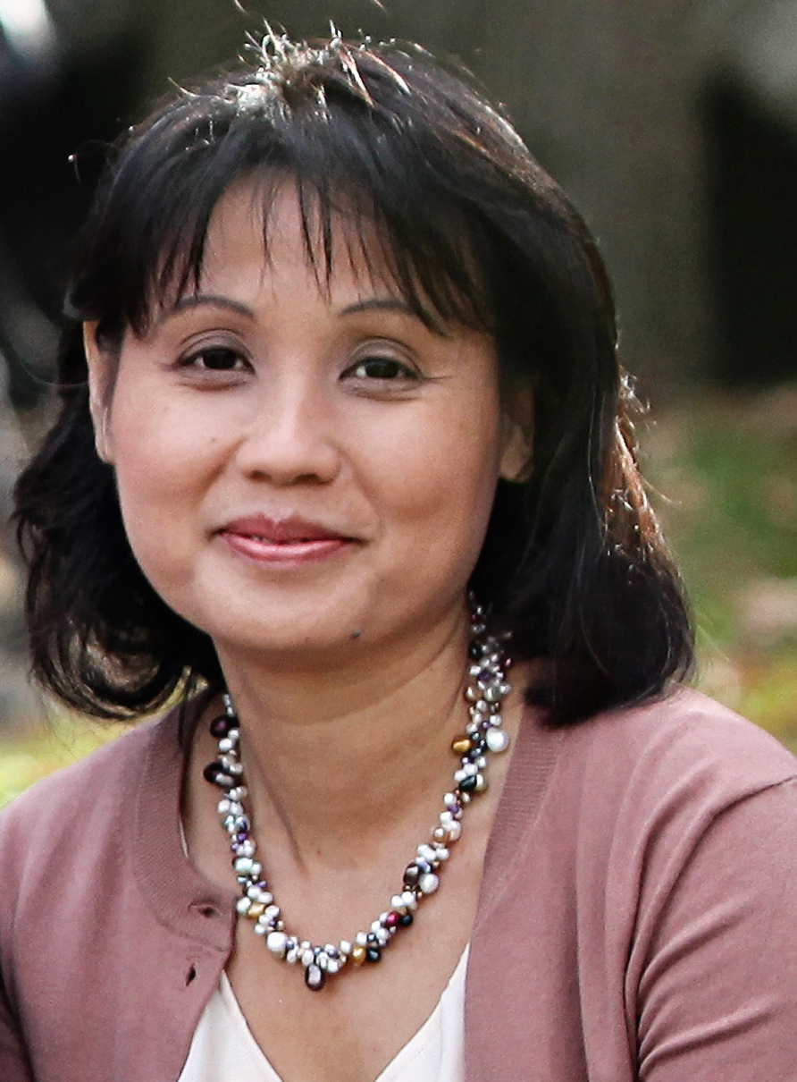
Your R&D Department
Practice group donations fund research and development that makes an impact on clinical care.
Dr. Rubin’s research led to the development and improvement of CT angiography as the principal means for assessing aortic disease.
His team’s work included refinement of MDCT techniques, invention of vessel measurement tools, and insights into aortic stent-grafts.
Dr. Mintun’s research developed functional brain imaging with PET that laid the groundwork for functional MRI which is now in common use in neuroradiology.
His research around amyloid imaging of the brain assisted in creating a better understanding of the biology of Alzheimer’s disease.
Geoffrey D. Rubin, MD
1994 RSNA Research Scholar Grant recipient
Mark A. Mintun, MD
1998 RSNA Research Scholar Grant recipient
Dr. Vo’s research on high resolution MR venography of occult venous malformations.
Her research assessed the clinical utility of a novel MR sequence that was developed at her MIR institution. This BOLD Venography sequence is now known as the SWI (susceptibility sequence) and is widely used in clinical practice.
Katie D. Vo, MD
1998 RSNA Research Fellow Grant recipient
13

Slide 14
Ready to make a VIP commitment
or need more information?
We appreciate your consideration for support. If you would like to make a donation, schedule a web meeting, or need additional information, please contact:
Bob Leigh
Senior Manager, Fund Development
RSNA R&E Foundation
(630) 590-7760
Central Standard Time
rleigh@rsna.org
14

